Slide 1
Software, Databases and Standards

Slide 2
SBML = Systems Biology Markup Language
Computational modeling becoming more prominent (again?)
Many software tools are available & more are being developed
More papers involve computational modeling
Clearly need a common format for exchanging models
Allows exchange and publication of models
Among collaborators, in journals, on web sites, etc.
Removes opportunities for translation errors
Allows resources to build on each other’s work
Helps the scientific process
Helps encourage computational modeling
SBML project an effort to define and evolve such a format
Notes:
because of the efforts of people
like hiroaki kitano and the sheer
amount of data being generated
by genome projects, we’re seeing
a resurgence of interest in
computational modeling

Slide 3
SBML: A Lingua Franca
A machine-readable format for representing computational models of biochemical networks
Defined in UML-like diagrams & XML Schema
Primarily targeted at XML, but independent of it
Intended for software tools, not for humans
Best for exchange—an intersection, not a union, of features
Not intended to replace application’s internal format
Arose in a multi-group collaboration started in 2000 for the Kitano Symbiotic Systems project (Doyle & Kitano PIs)
Influenced by metabolic simulation software (e.g., Gepasi)
But today is being applied more broadly (e.g., signaling)
Notes:
SBML is defined abstractly but in reality it is targeted towards XML. The vocabulary of SBML uses terms that reflect the natural conceptual constructs used by modelers who interact with biochemical network models.
A model in SBML is defined in terms of a list of elements: units, compartments, chemical species, and so on.
An important point to keep in mind is that users are not intended to write SBML or XML -- it is the software tools that read and write the format.

Slide 4
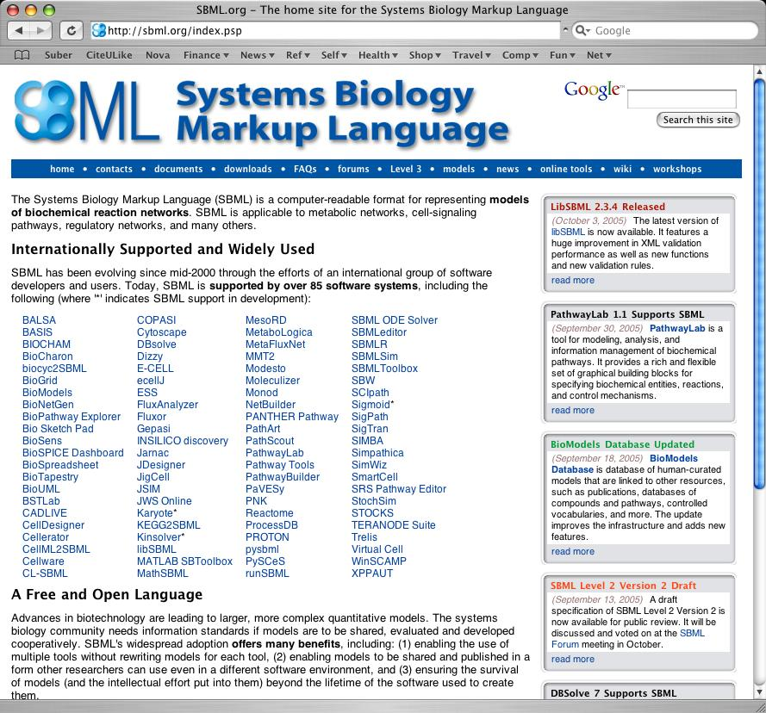
Broad Acceptance of SBML
SBML has become the international de facto standard
Supported by over 100 software systems
Simulators
Databases
Analysis tools
Editing tools
Used in textbooks and university courses

Slide 5
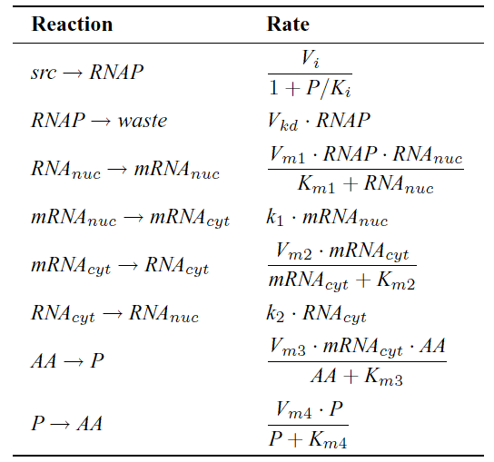
What Kind of Models?
Chemical reactions translated to computable form:
d[mRNA_{cyt}]/dt = k₁[mRNA_{nuc}] -
(V_{m2}[mRNA_{cyt}])/([mRNA_{cyt}] + K_{m2})
Model can also include:
Compartments
Additional math formulas
Discrete events
Notes:
here’s a toy example to make some of this more concrete.
(pick smth that involves a couple of reactions)

Slide 6
Structure of Models Expressed in SBML
Beginning of SBML model definition
List of function definitions
List of unit definitions
List of compartment types
List of molecular species types
List of compartments
List of species
List of parameters
List of initial assignments
List of rules
List of constraints
List of reactions
List of events
End of SBML model definition

Slide 7
Structure of Models Expressed in SBML
Beginning of SBML model definition
List of function definitions
List of unit definitions
List of compartment types
List of molecular species types
List of compartments
List of species
List of parameters
List of initial assignments
List of rules
List of constraints
List of reactions
List of events
End of SBML model definition
Molecules,
ions, etc.

Slide 8
Structure of Models Expressed in SBML
Beginning of SBML model definition
List of function definitions
List of unit definitions
List of compartment types
List of molecular species types
List of compartments
List of species
List of parameters
List of initial assignments
List of rules
List of constraints
List of reactions
List of events
End of SBML model definition
Define locations
where chemical
are co-located

Slide 9
Structure of Models Expressed in SBML
Beginning of SBML model definition
List of function definitions
List of unit definitions
List of compartment types
List of molecular species types
List of compartments
List of species
List of parameters
List of initial assignments
List of rules
List of constraints
List of reactions
List of events
End of SBML model definition
Processes—
reactions,
translocation,
modification,
etc.

Slide 10
Structure of Models Expressed in SBML
User-defined functions that can be called within math expressions
Beginning of SBML model definition
List of function definitions
List of unit definitions
List of compartment types
List of molecular species types
List of compartments
List of species
List of parameters
List of initial assignments
List of rules
List of constraints
List of reactions
List of events
End of SBML model definition

Slide 11
Structure of Models Expressed in SBML
Redefinition of built-in default units, or new units defined from base units
Beginning of SBML model definition
List of function definitions
List of unit definitions
List of compartment types
List of molecular species types
List of compartments
List of species
List of parameters
List of initial assignments
List of rules
List of constraints
List of reactions
List of events
End of SBML model definition

Slide 12
Structure of Models Expressed in SBML
Beginning of SBML model definition
List of function definitions
List of unit definitions
List of compartment types
List of molecular species types
List of compartments
List of species
List of parameters
List of initial assignments
List of rules
List of constraints
List of reactions
List of events
End of SBML model definition
Math equations
(for things that can’t be expressed
simply as
reactions)

Slide 13
Structure of Models Expressed in SBML
Beginning of SBML model definition
List of function definitions
List of unit definitions
List of compartment types
List of molecular species types
List of compartments
List of species
List of parameters
List of initial assignments
List of rules
List of constraints
List of reactions
List of events
End of SBML model definition
Assumptions about
the values of
system variables

Slide 14
Structure of Models Expressed in SBML
Beginning of SBML model definition
List of function definitions
List of unit definitions
List of compartment types
List of molecular species types
List of compartments
List of species
List of parameters
List of initial assignments
List of rules
List of constraints
List of reactions
List of events
End of SBML model definition
Discontinuous
changes in
values of variables

Slide 15
What Are SBML Levels?
SBML developed in stages or Levels
Level 1: mostly basic compartmental modeling
Level 2: new features (but more complexity), such as:
MathML instead of text strings for math expressions
Support for user-defined functions
Support for conditional events
Level 3: under development; expect modular support for
Multistate species
Model composition (submodels)
Diagrams
Spatial features
… and many more

Slide 16
LibSBML
Library for manipulating data in SBML format
An embeddable library for application developers
Reads, writes, validates, converts SBML
Written in portable ISO C and C++
Currently supports Linux, Windows, MacOS X
APIs for C, C++, Java, Lisp, Perl, Python, MATLAB
Fast, with a small runtime memory footprint
Open-source under LGPL (thus commercial friendly)

Slide 17
Related Efforts
Some similarity to CellML (www.cellml.org)
SBML is somewhat closer to rep. used in simulators
CellML is somewhat more abstract and broader
Based on modular components
Both SBML and CellML teams are working together
Committed to bringing them closer together
SBML Level 2 adopted features from CellML
BioPAX (www.biopax.org)
A common exchange format for databases of pathways
SBML & BioPAX are complementary, not competing
SBML and BioPAX teams working together to define linkages between SBML and BioPAX representations

Slide 18
SBGN

Slide 19
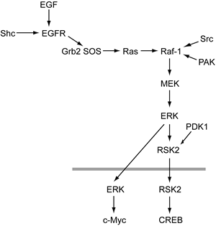
Background
Human communication enhanced by diagrams
No current standard for network diagrams in biology
No consistency between authors
No consistency between papers
No consistency between publications
A standard would be good
Readers would need to learn fewer notations
Easier to compare diagrams
Could develop software tools

Slide 20
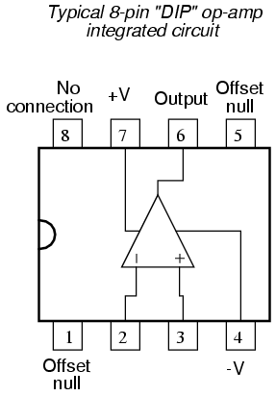
Value of Standard Notations
Well known in engineering fields
E.g.: electronic circuit diagrams, UML for software
Standardized (e.g., IEEE)
Taught in textbooks
Supported by software
Automated verification
Generation of models
Why not apply this lesson, and standardize a notation for cellular networks?

Slide 21
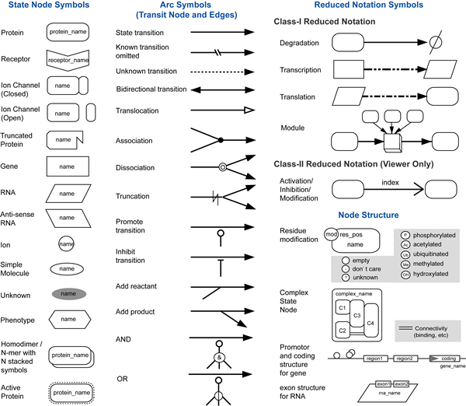
Process Diagram Notation Elements
Kitano et al., Nature Biotech, 23(8):961, 2005

Slide 22
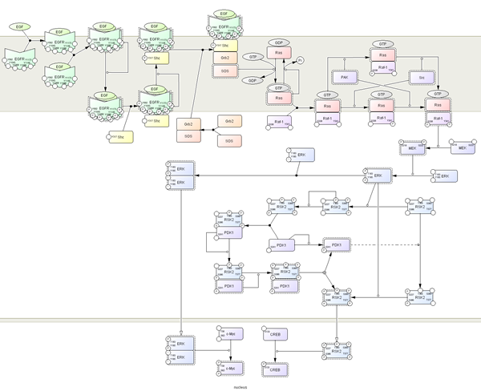
Starting Points: Process Diagram Notation

Slide 23
BioModels.net

Slide 24
Background
SBML successful as glue
Coalescing a communitiy of modelers
Allowing interchange where none existed before
Between software & researchers at many different levels
SBML not without problems
But that community is committed to working them out

Slide 25
Agreement on format opens new possibilities
Can think about answering FAQ:
“Is there a database of models somewhere?”
Discussions with SBML Team (esp. Andrew Finney) and Nicolas Le Novère team lead to ideas:
Could develop a database using XML technology
Le Novère at EBI had experience already
But early realization was that database is not enough
Need curate the models
Need annotate with references to other data sources

Slide 26
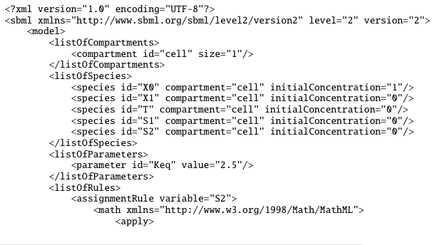
Why do the search issues arise?
SBML provides syntax
Unregulated
Low info content
SBML model doesn’t encode semantics

Slide 27
BioModels Database: the driving force
The vision:
Free global database of curated & annotated published models
The prerequisites:
Guidelines for curating models
Controlled vocabulary for computational models
SBO
BMDB
MIRIAM

Slide 28
BioModels Database
Aims to be the Swiss-Prot of quantitative modeling
Stores & serves quantitative models of biomed. interest
Only models described in peer-reviewed scientific literature
Models are curated by humans: computer software checks syntax, humans check semantics
Models are simulated to check correspondence to reference
Model components are annotated to improve identification and retrieval
Accepted in SBML and CellML formats, served in several (SBML, XPP, CellML, diagram; more coming)

Slide 29
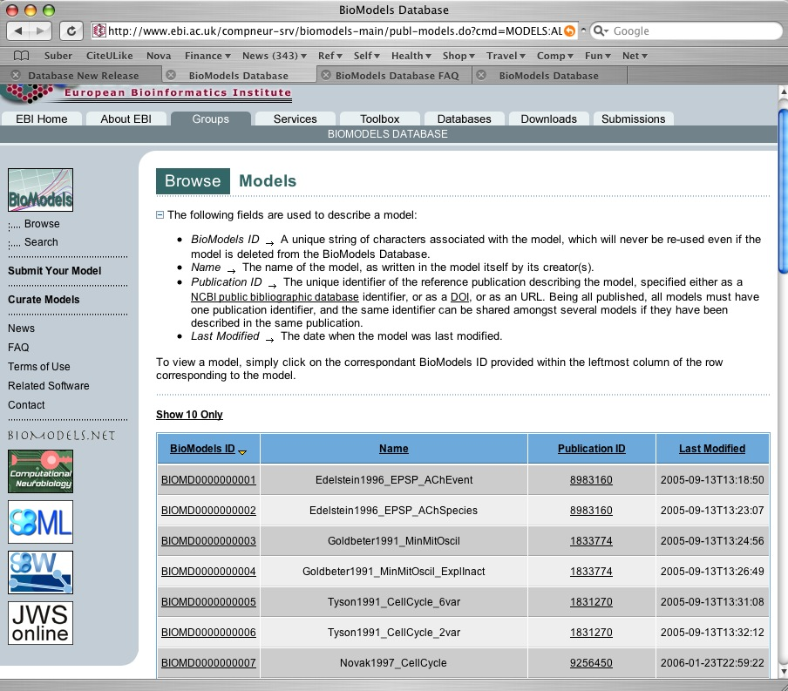
www.ebi.ac.uk/biomodels

Slide 30
SBO = Systems Biology Ontology
Occupy a space currently not filled by other ontologies
Primarily for describing rate laws and constituents
Classification of rate laws
“Henri-Michaelis-Menten”, “reversible mass action”, etc.
Each term includes a MathML function defining the rate expression
CV for the roles of reaction participants
“substrate”, “catalyst”, “competitive inhibitor”, etc.
CV for the roles of parameters in quantitative models
“Hill coefficient”, etc.

Slide 31
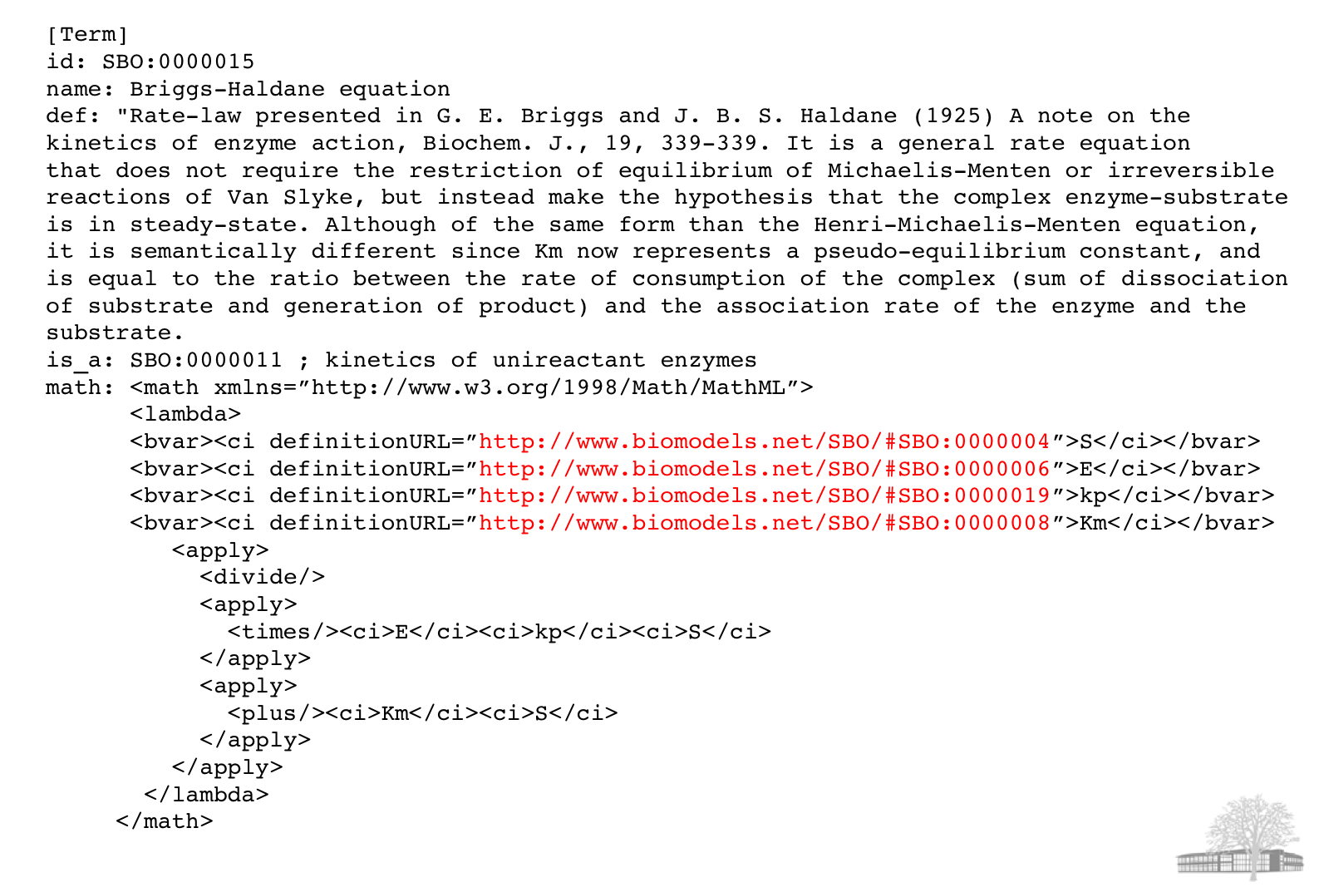
Example of SBO Term in OBO Format
From Nicolas Le Novère @ EBI

Slide 32
SBML: Tellurium Support
r = te.loadSBMLModel("https://www.ebi.ac.uk/biomodels-main/download?mid=BIOMD0000000010")
r.getNumFloatingSpecies()
print (r.getSBML())
print (te.sbmlToAntimony (r.getSBML()))

Slide 33
Annotation: Tellurium Support
r

Slide 34
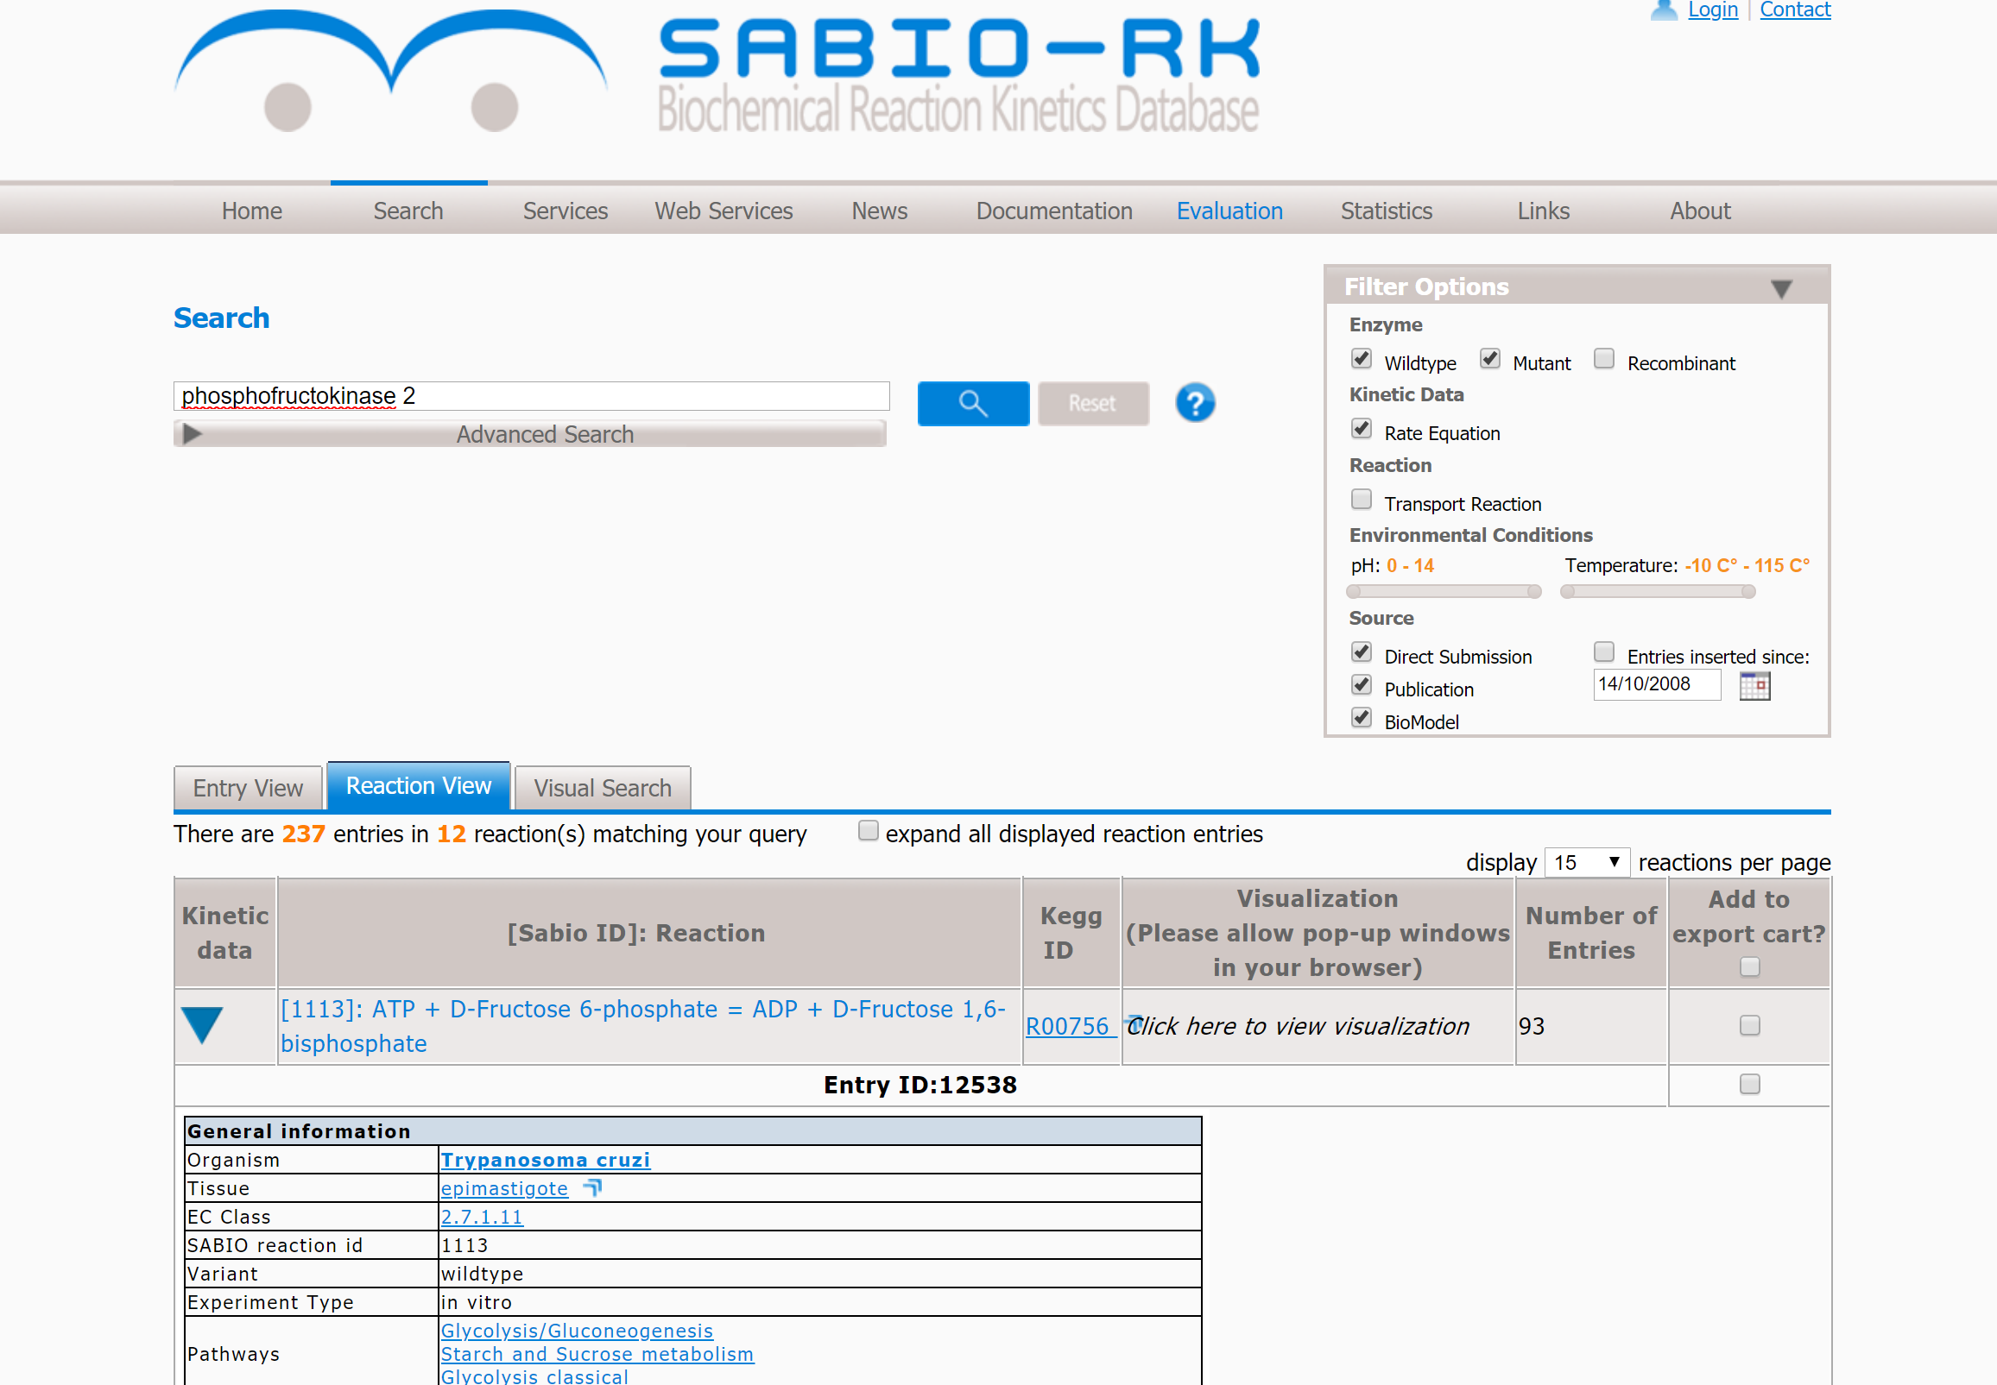
SABIO-RK

Slide 35
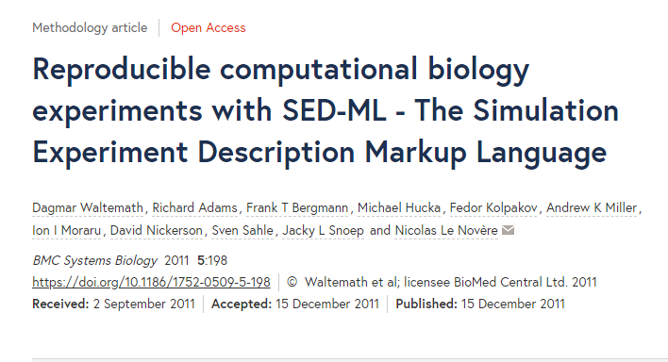
SED-ML

Slide 36
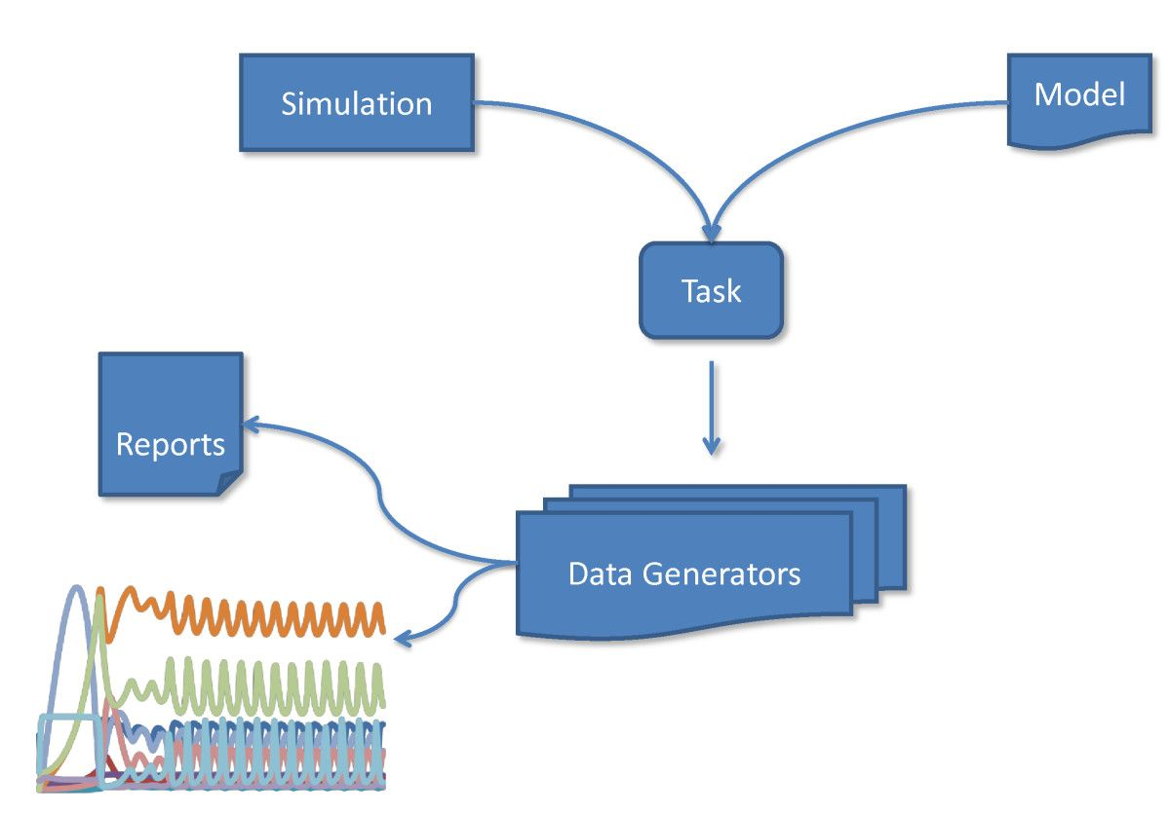
SED-ML

Slide 37

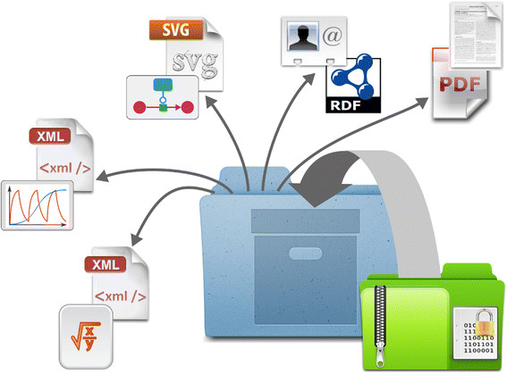
COMBINE Archive
A single package that includes everything you need to reproduce a model.
Manifest
File_1
.
.
File_n
Metadata.rdf
<?xml version="1.0" encoding="utf-8"?> <omexManifest xmlns="http://identifiers.org/combine.specifications/omex-manifest"> <content location="./manifest.xml" format="http://identifiers.org/combine.specifications/omex-manifest"/> <content location="./model/model.xml" format="http://identifiers.org/combine.specifications/sbml"/> <content location="./simulation.xml" format="http://identifiers.org/combine.specifications/sedml"/> <content location="./article.pdf" format="application/pdf"/> <content location="./metadata.rdf" format="http://identifiers.org/combine.specifications/omex-metadata"/> </omexManifest>

Slide 38
COMBINE Archive
ZIP File
Manifest
File_1
.
.
File_n
Metadata.rdf
<?xml version="1.0" encoding="utf-8"?> <omexManifest xmlns="http://identifiers.org/combine.specifications/omex-manifest"> <content location="./manifest.xml" format="http://identifiers.org/combine.specifications/omex-manifest"/> <content location="./model/model.xml" format="http://identifiers.org/combine.specifications/sbml"/> <content location="./simulation.xml" format="http://identifiers.org/combine.specifications/sedml"/> <content location="./article.pdf" format="application/pdf"/> <content location="./metadata.rdf" format="http://identifiers.org/combine.specifications/omex-metadata"/> </omexManifest>

Slide 39
Other Tools
COPASI - Demo
SBW
JWS Online - Demo
CellDesigner
PathwayDesigner
http://sysbioapps.dyndns.org/
VCell
iBioSim

Slide 40
Reusable Software Libraries
libRoadRunner
libSBML
libSEDML
libCOMBINE
libAntimony

Slide 41
Capabilities of Platforms
Creating and editing models
Running time course simulations
Event handling – Demo
Calculating the steady state
Parameter fitting
Bifurcation and stability analysis
Packaging a model/data for publications and sharing
Real-time simulation - Demo

Slide 42
Real-time simulation and Novel Visualization

